Slide 1
Classification Model (Predict Which Customer Will Have Default Payment Next Month)
Done By: Toh Kien Yu (P2222291)

Slide 2
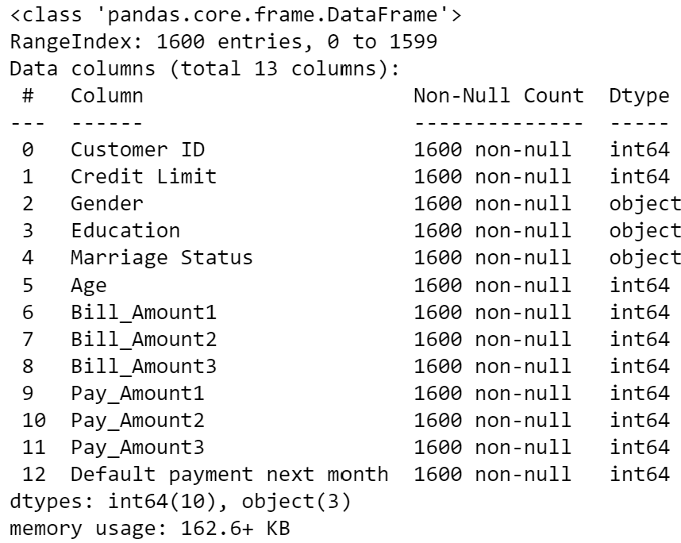
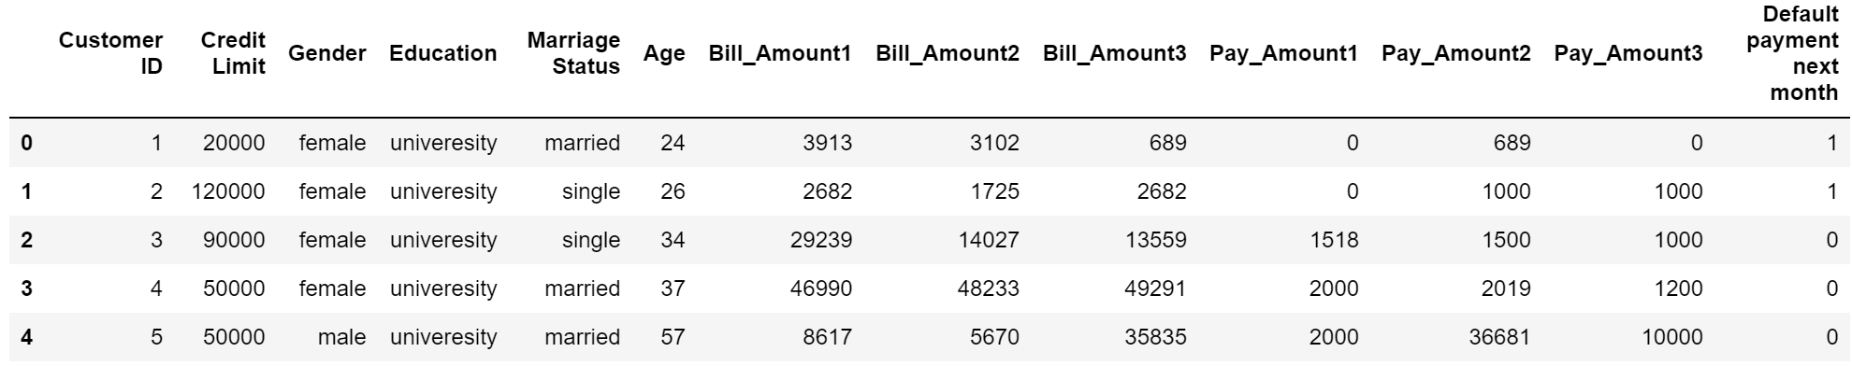
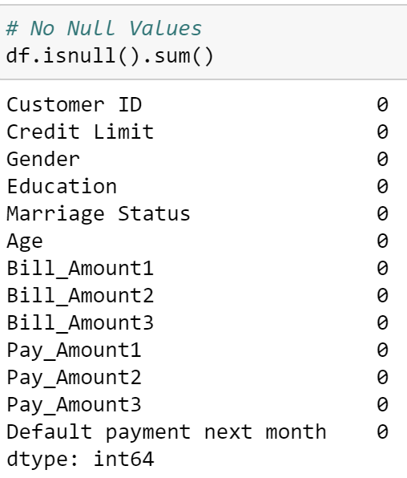
Nature of Dataset
(1600 rows, 13 columns)
Categorical Data
Gender (female, male)
Education (‘univeresity’, post-graduate, high school)
Marriage Status (married, single,)
Default payment next month (0 = non default, 1 = default)
Numeric Data
Customer ID
Credit Limit
Age
Bill_Amount1 (credit card bill amount 1 month ago)
Bill_Amount2 (credit card bill amount 2 month ago)
Bill_Amount3 (credit card bill amount 3 month ago)
Pay_Amount1 (the amount customer paid 1 month ago)
Pay_Amount2 (the amount customer paid 2 month ago)
Pay_Amount3 (the amount customer paid 3 month ago)

Slide 3
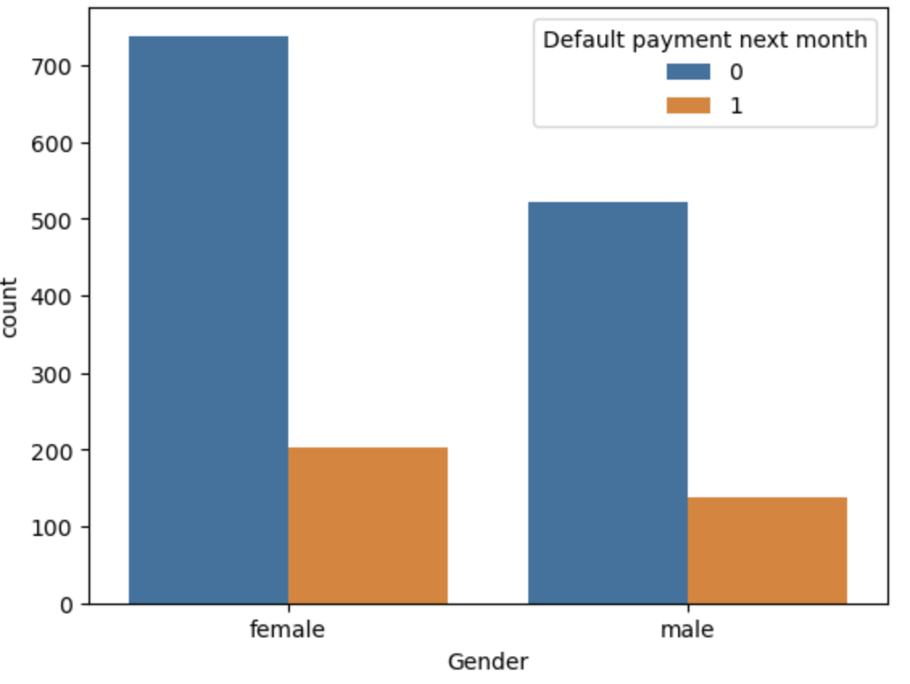
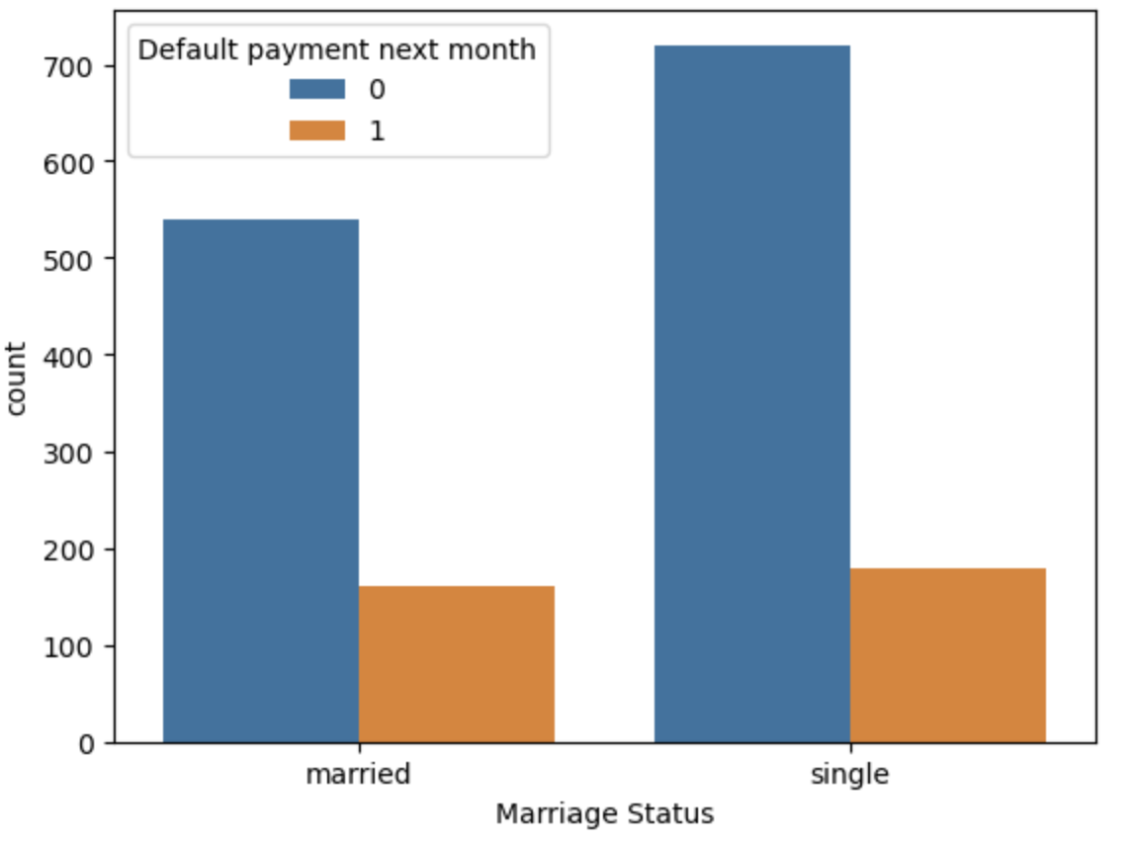
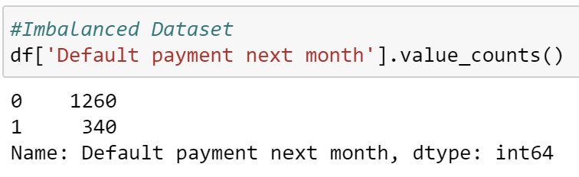
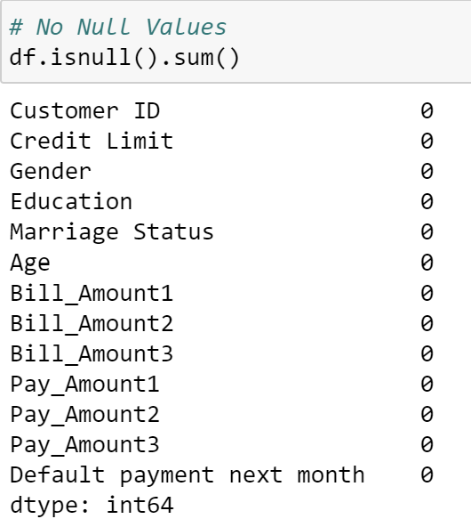
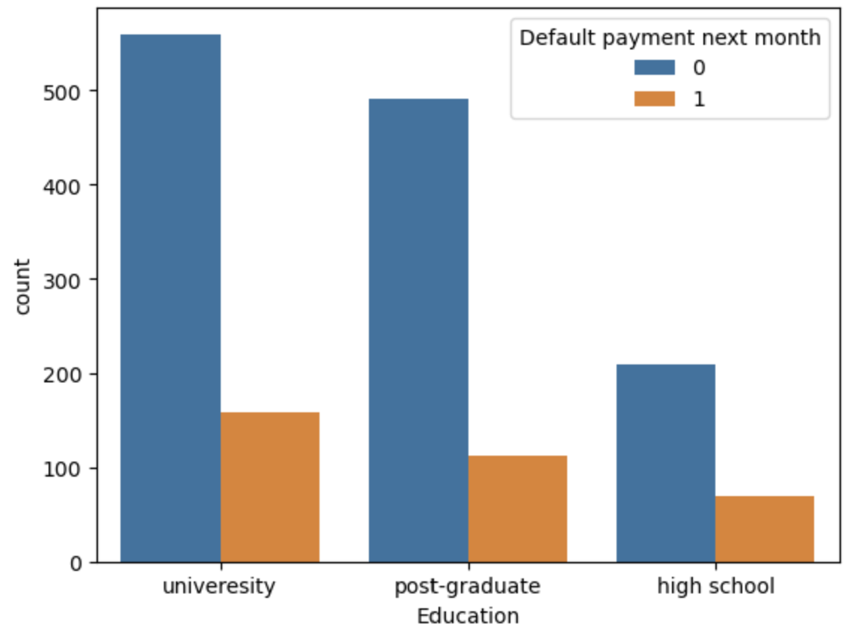
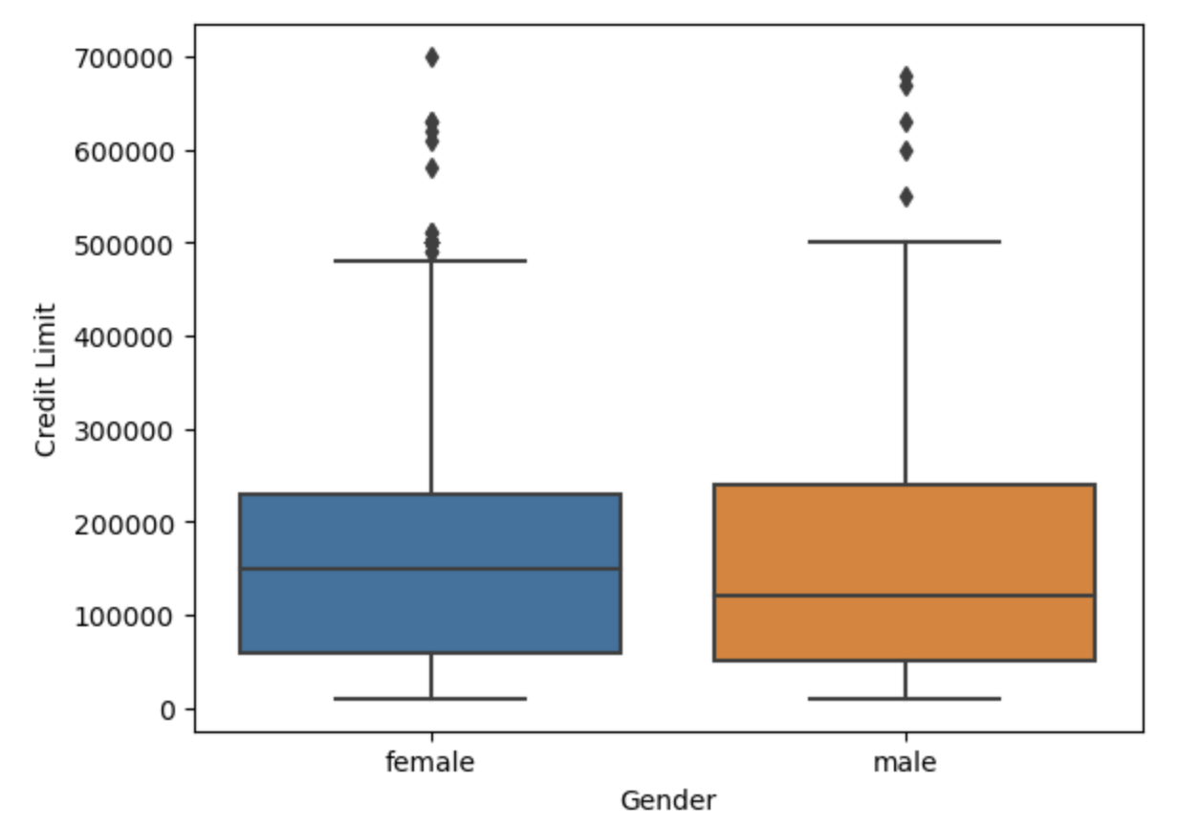
Data Exploration
Note: Imbalanced dataset
From the graph, there is more non defaulting payment than defaulting
From the graph, singles are more likely to non-default payments
Note: Imputation is not needed
There are more non defaulting payments than those defaulting payments
From the box and whisker graph, female have a higher median credit limit than male.

Slide 4
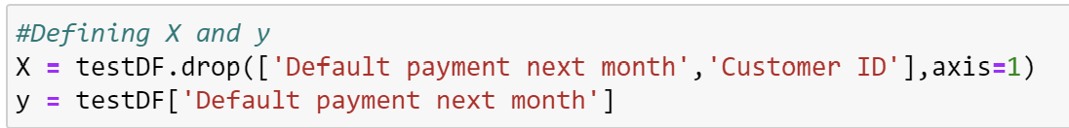
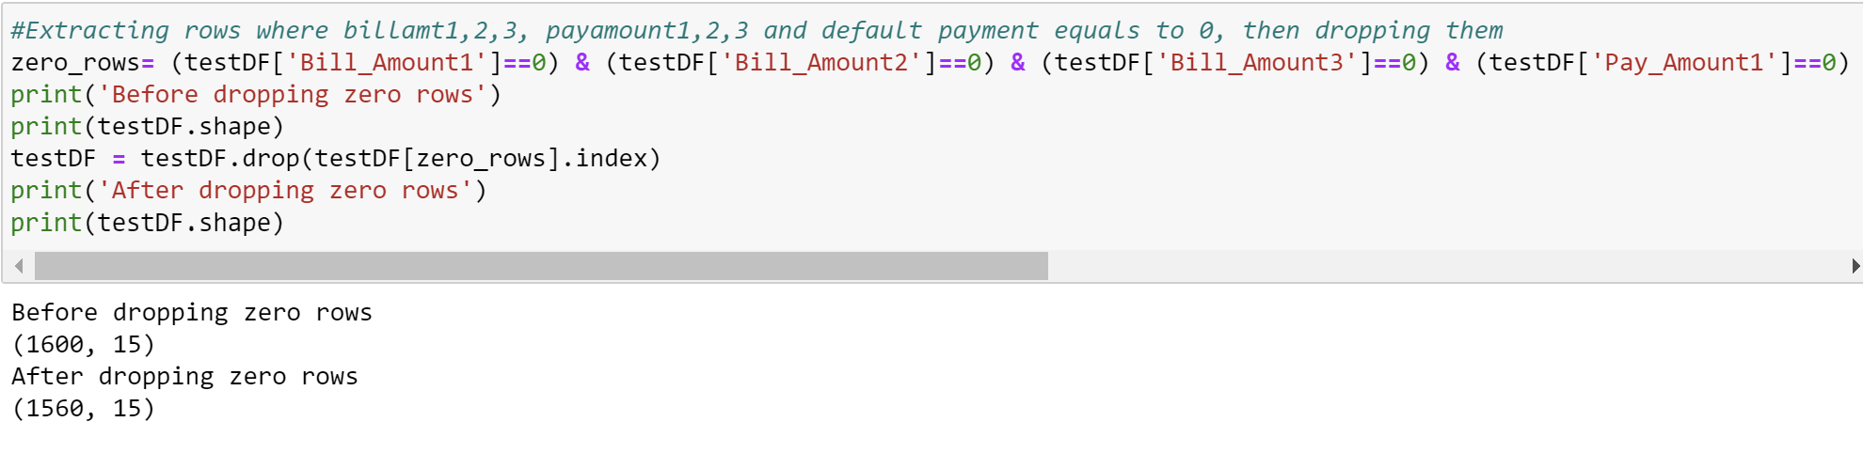
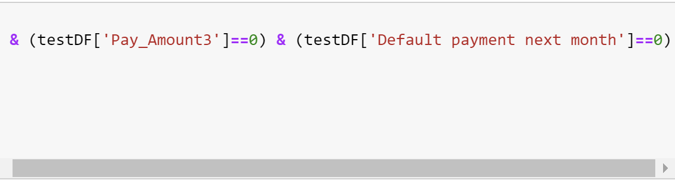
Data Preprocessing
# Rename typo error.
# Encode categorical variables.
Feature Engineering
Feature engineer is the process to create additional relevant features from the existing raw features of the data to improve the learning algorithm. ‘zeroBill’ is created to sieve out those people who do not have a bill at the end of the month.
Feature Selection
Feature Selection is done to get rid of features that are redundant by taking the best subset of the dataset.
X drops the target variable (‘Default payment next month’) and identifying column (‘Customer ID’).
y is the target variable
(‘Default payment next month’)
Rows that contain ‘0’ for Bill_Amount1, , Bill_Amount2, Bill_Amount3, Pay_Amount1, Pay_Amount2, Pay_Amount3, Default payment next month are all dropped as people who do not have bills will naturally non default payment. Hence, improving the model’s accuracy.

Slide 5
Algorithms Used
Logistic Regression
Gradient Boosting Classifier
Random Forest
GaussianNB
HistGradientBoosting Classifier
Logistic Regression
Predict binary variable/likelihood of an event (0 = ‘non default’, 1 = ‘default’ )
Handles categorical variable.
Performs well in smaller dataset (1600 Rows, 13 Columns).
Easy to implement.
Low bias and high variance
Random Forest
Good predictions that can be easily understood over decision trees.
Reduces overfitting by averaging multiple decision trees.
Not sensitive by outliers.
HistGradientBoosting Classifier
Histogram Based Gradient Boosting
Able to handle numeric and categorical variable
Able to recognize complex patterns which results in more accurate prediction
Gradient Boosting Classifier
One of the most powerful algorithms in machine learning
Good at decreasing the bias error.
A variety of options to choose from when hyperparameter tuning
GaussianNB
Easy to Implement
Fast predictions
Easy to understand algorithm
Can predict well with less data
Higher bias and low variance

Slide 6
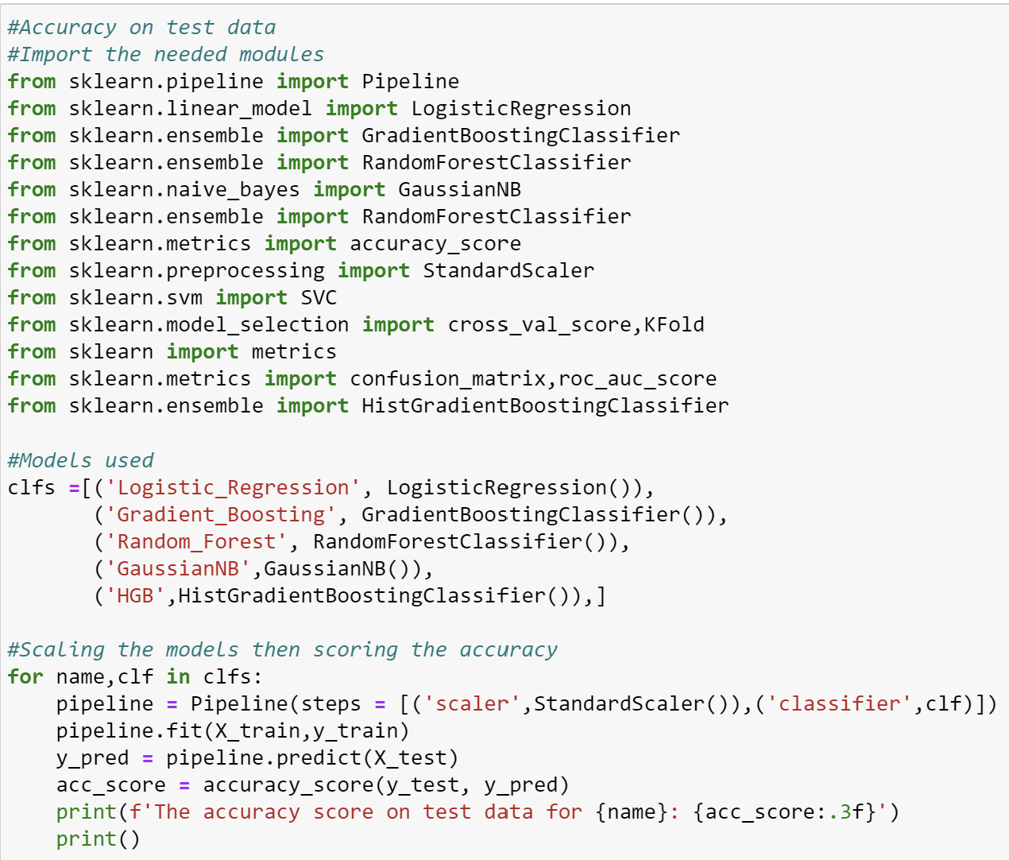
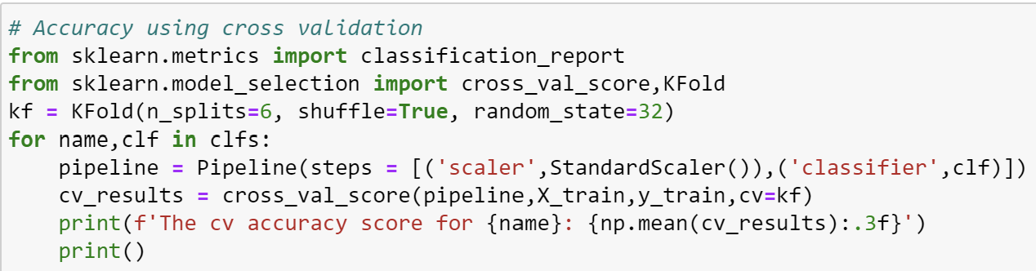
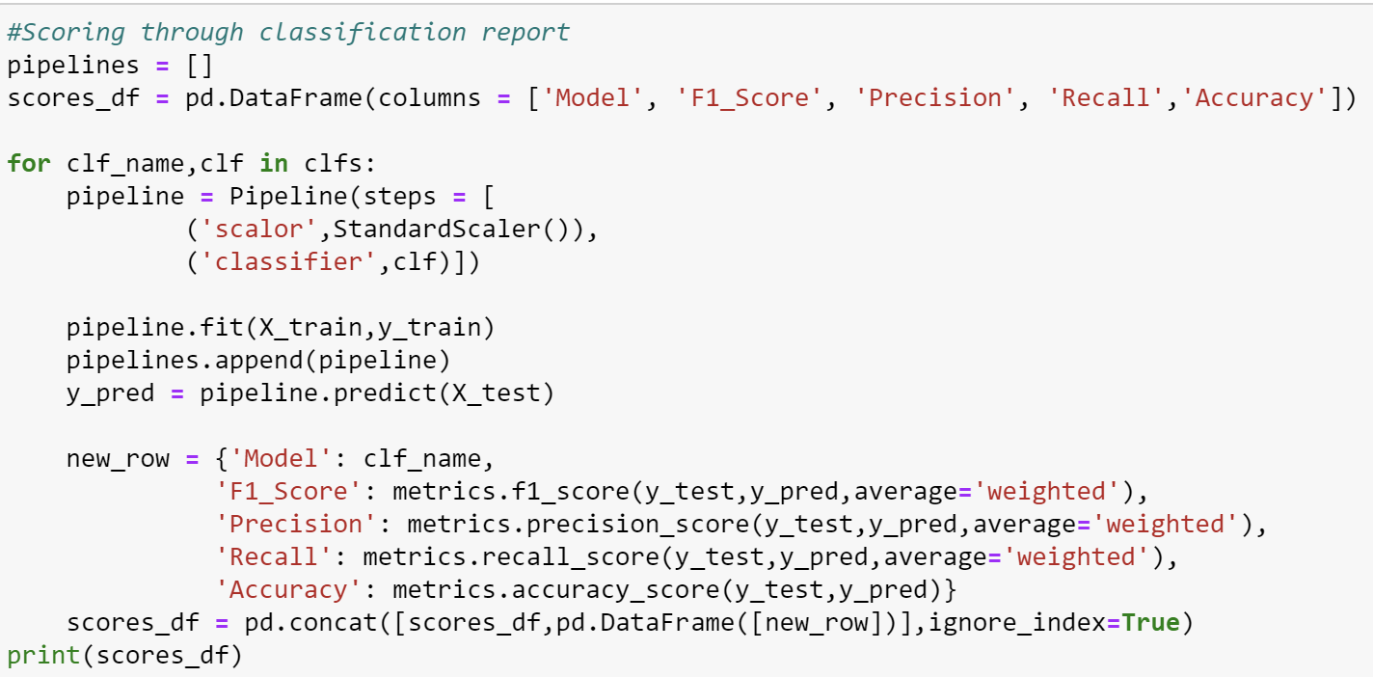
Test and Score Code (Before Hyperparameter Tuning)
An 80:20 ratio between training and test data is chosen where 80% of the data is for training and 20% is for testing.

Slide 7
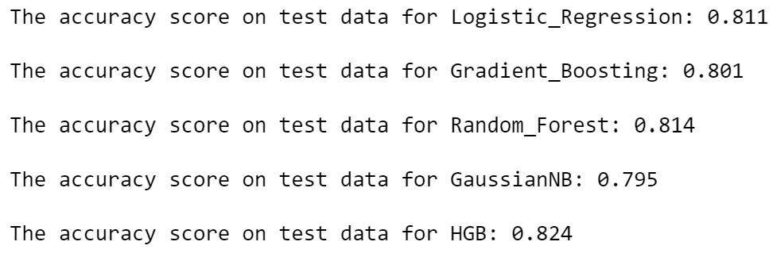
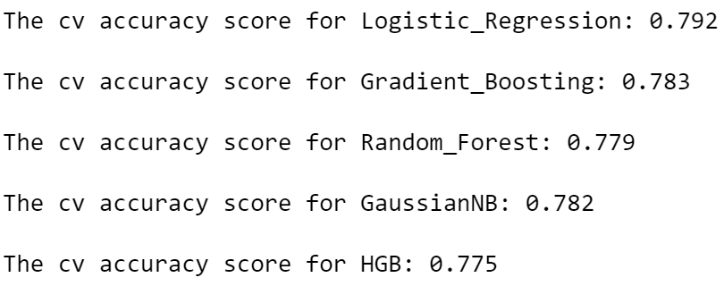
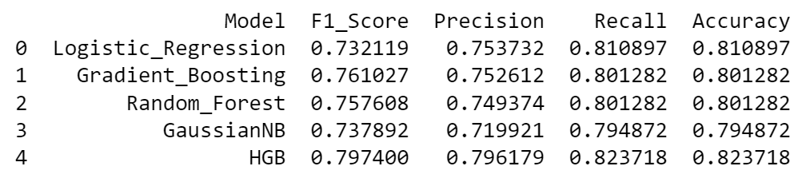
Test and Score (Before Hyperparameter Tuning)
Accuracy On Test Data
Cross Validation Accuracy Score
Random Forest Algorithm has a highest Accuracy Score of 0.814 compared to the other algorithms. This tells us that the model is good at making accurate predictions on the likelihood of an ‘unseen’ person that will default payment
Gaussian Naïve Bayes Algorithm has a highest Cross Validation Accuracy Score of 0.782 compared to the other algorithms. This tells us that the model making accurate prediction 78% of the time
Classification Report
From the 3 test and score results obtained,
Random Forest has the highest accuracy on test data.
Gradient Boosting has the highest cross validation accuracy score
HGB has the highest F1 Score
HGB Algorithm has a highest F1 Score of 0.797 compared to the other algorithms.
This tells us that the model have high precision and recall.
In turn, the algorithm is able to produce more relevant results which also leads to higher performance.

Slide 8
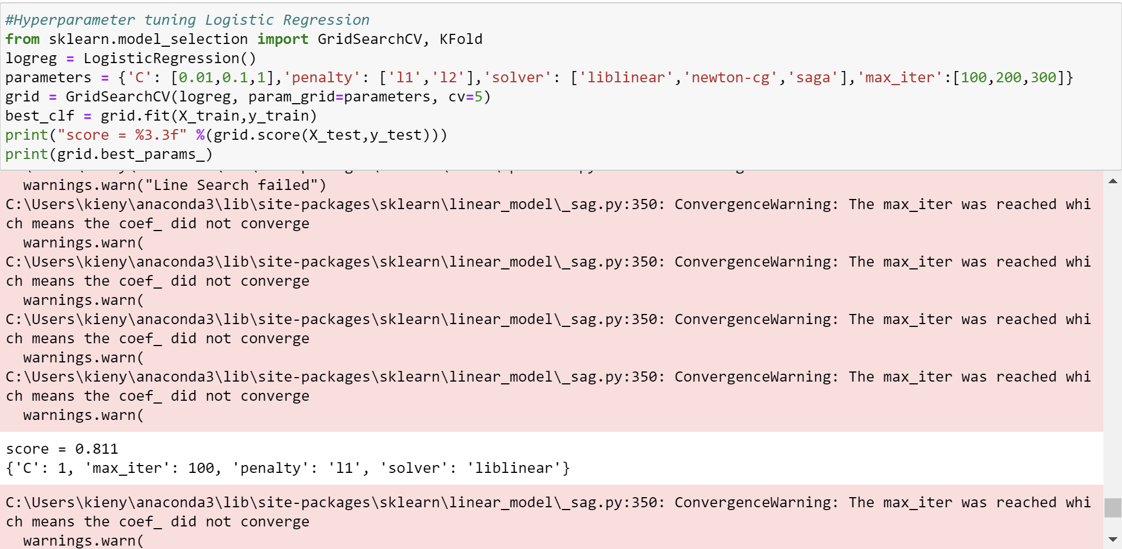
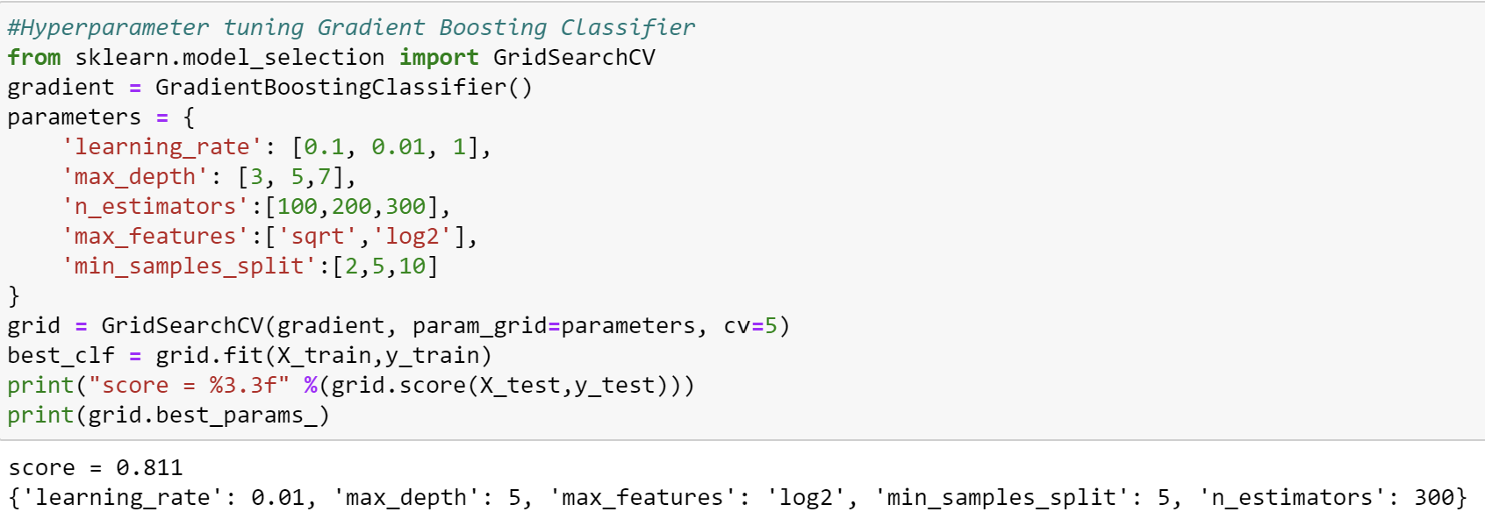
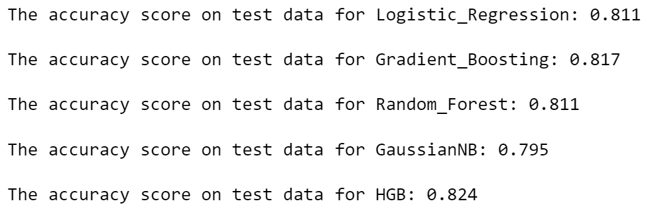
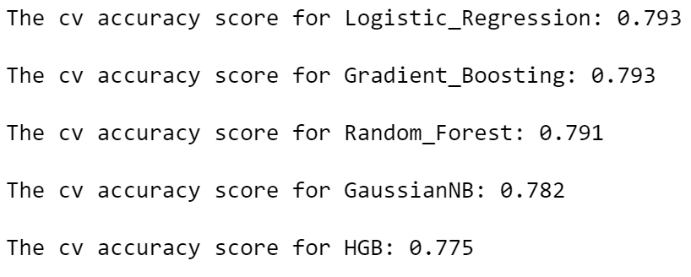
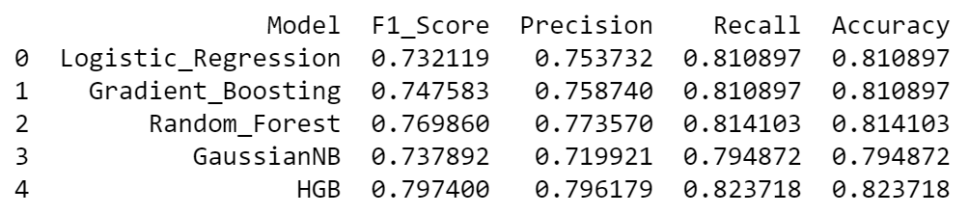
Test and Score (After Hyperparameter Tuning)
Hyperparameter Tuning
Accuracy On Test Data
After tuning the models,
Gradient Boosting Accuracy on Test Data increased from 0.801 to 0.811 and cross validation score increased from 0.783 to 0.793.
Logistic Regression’s Accuracy on Test Data remained stagnant while the cross-validation accuracy score only increased by 0.01.
Overall, hyperparameter tuning is not as effective for my classification model.
Cross Validation Accuracy Score
Classification Report

Slide 9
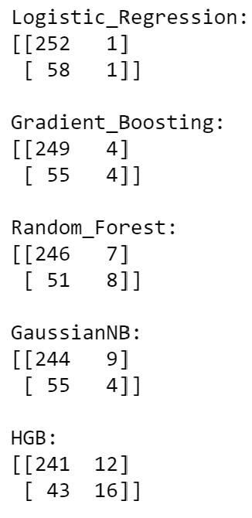
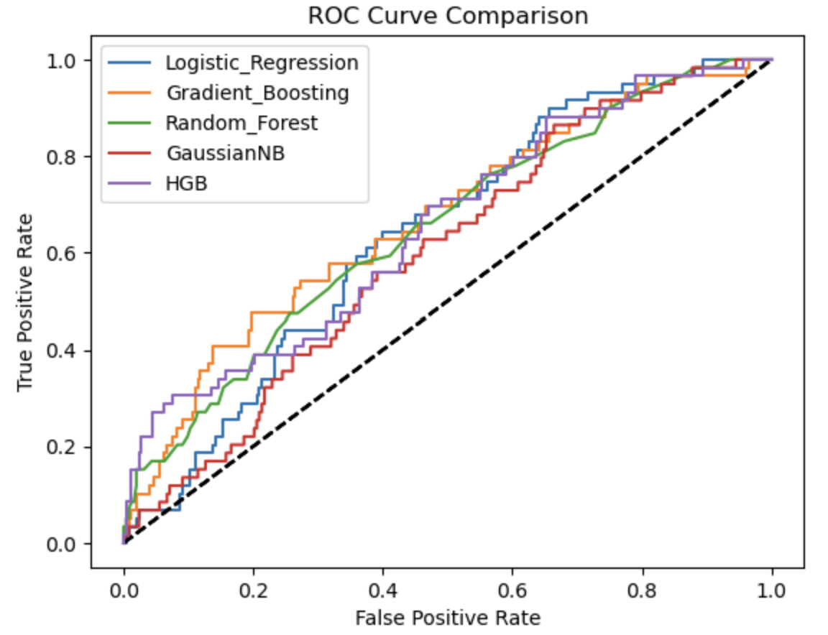
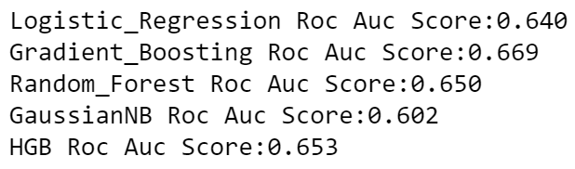
Evaluation
From the 5 algorithms chosen, all algorithms are able to give good accurate predictions on whether one will default payment.
However, Logistic Regression and HistGradient Boosting stood out among the rest
Logistic Regression algorithm is able to correctly predict and classify 252 people as ‘non-default’ while incorrectly predicting 1 person as ‘default’.
As well as correctly predicting and classifying 1 person as ‘default’ while incorrectly predicting 58 people as ‘non-default’
HistGradientBoosting algorithm is able to correctly predict and classify 241 people as ‘non-default’ while incorrectly predicting 12 person as ‘default’.
As well as correctly predicting and classifying 16 person as ‘default’ while incorrectly predicting 43 people as ‘non-default’
Imbalanced dataset will result in the model being bias towards the majority class.
This will result in the model accurately predicting ‘non default’ more and not as accurate when predicting ‘default’.
Confusion Matrix
From the confusion matrix, it tells us that the model is very good at predicting if one will not default payment but is not as good at predicting if one will default payment.
This is further strengthened by the point that the dataset is imbalanced.

Slide 10
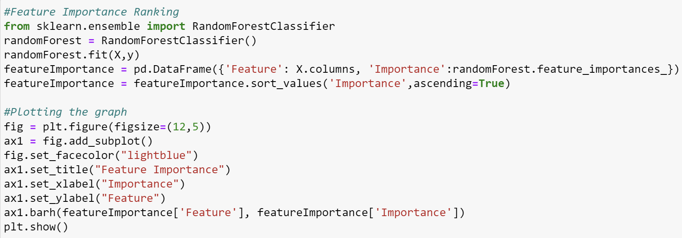
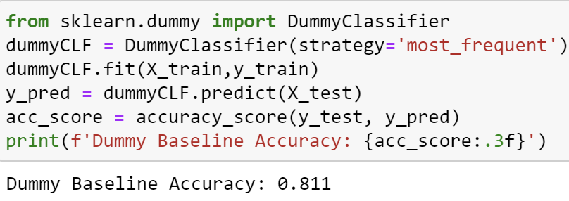
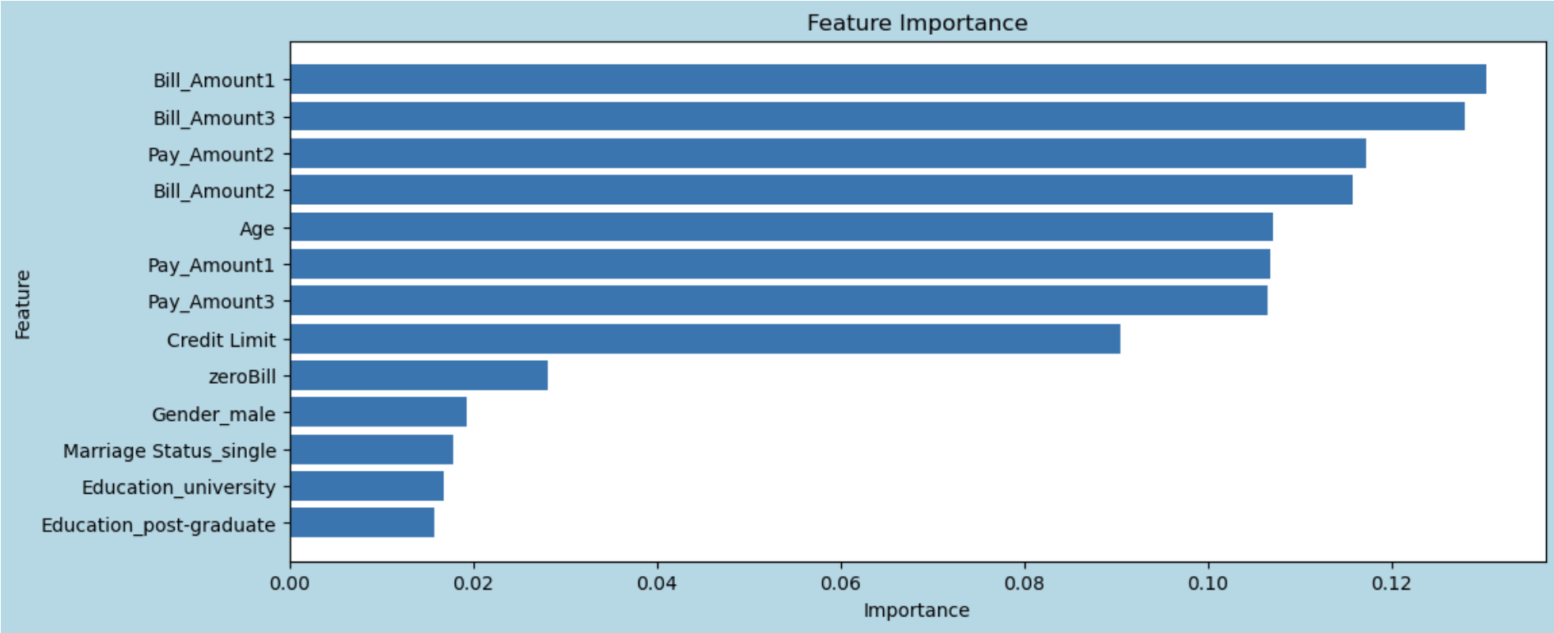
Conclusion
In Conclusion, this dataset has given me a deep understanding on the likelihood of one defaulting payment.
Upon considering all 3 different accuracy reports HistogramGradientBoosting is my most accurate model to predict if one will default payment.
The feature importance graph shows that:
The model relies heavily on the bill amount to predict if one will default payment.
The model relies on the education the least when predicting if one will default payment
This also means that bill amount strongly correlates if one will default payment
As compared to a dummy baseline, my model accuracy increased, my model can capture patterns in the data and make more accurate predictions.

Slide 11
Regression Model (Predict Housing Prices)
Done By: Toh Kien Yu (P2222291)

Slide 12
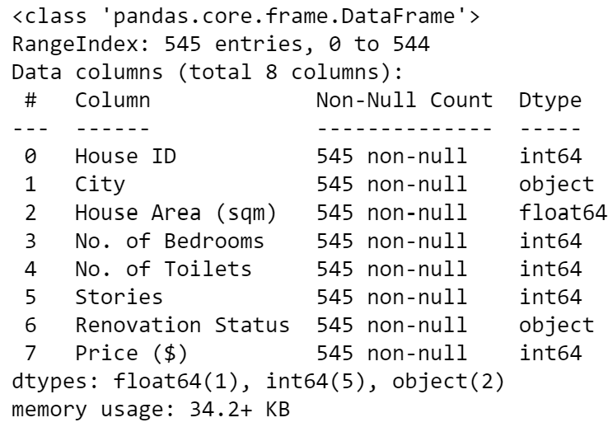
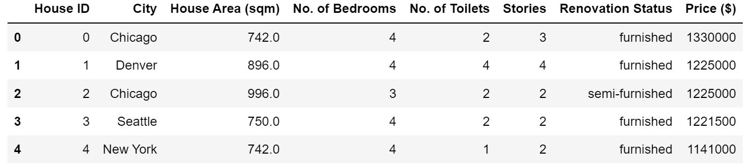
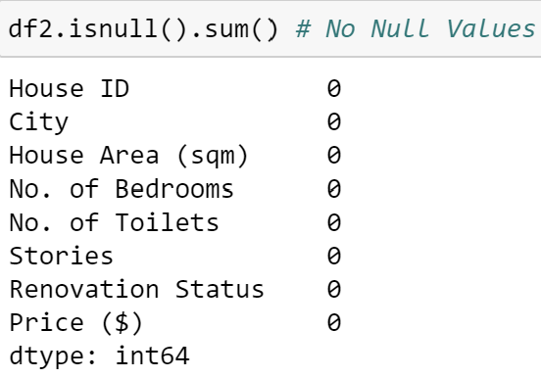
Nature of Dataset
(545 rows, 8 columns)
Categorical Data
City
Renovation Status (‘univeresity’, post-graduate, high school)
Numeric Data
House ID
House Area (sqm)
No. of Bedrooms
No. of Toilets
Stories
Price ($)
Imputation is not needed

Slide 13
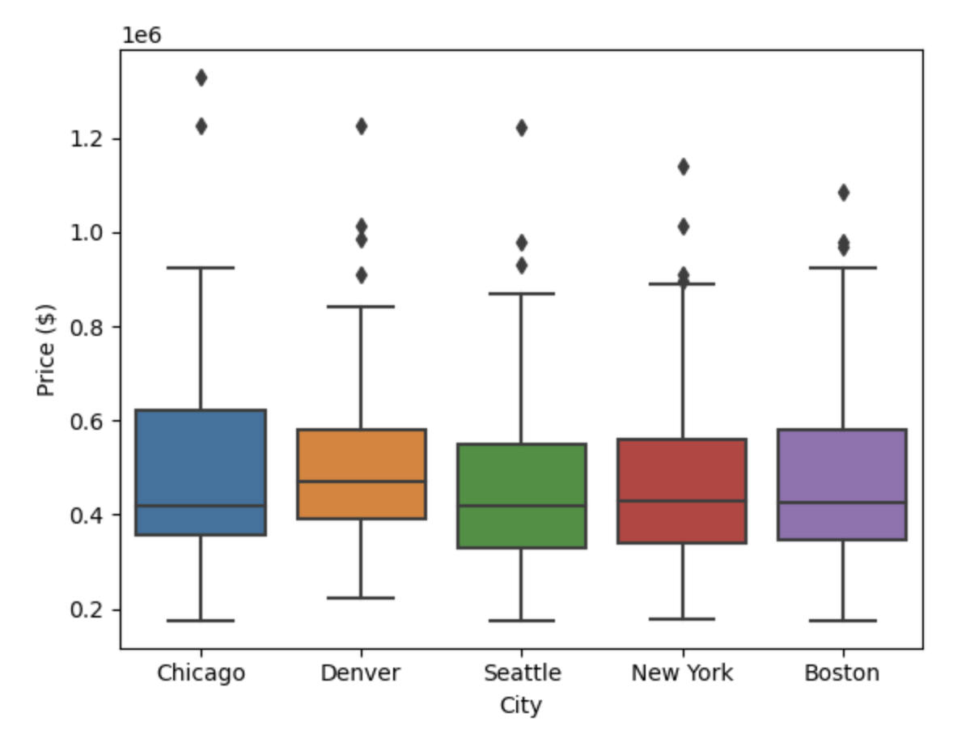
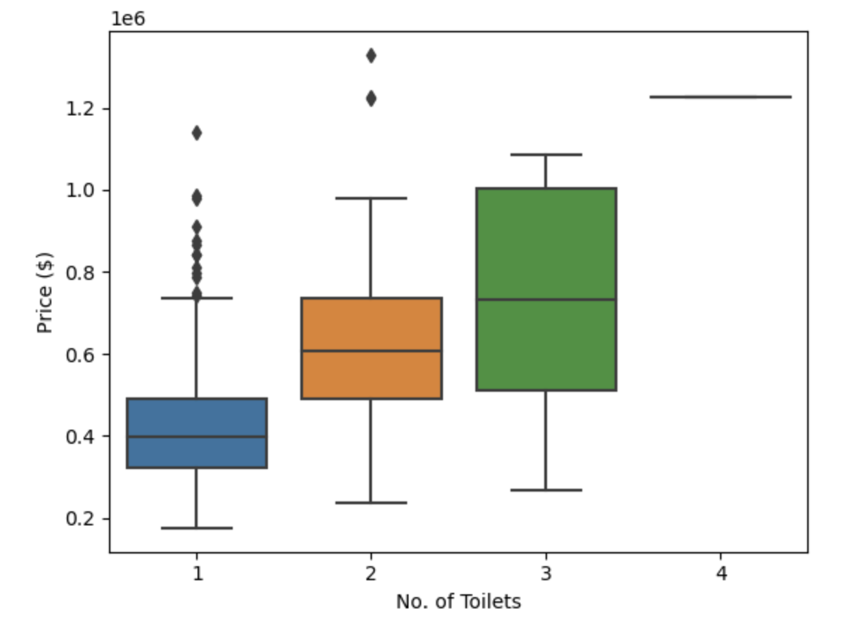
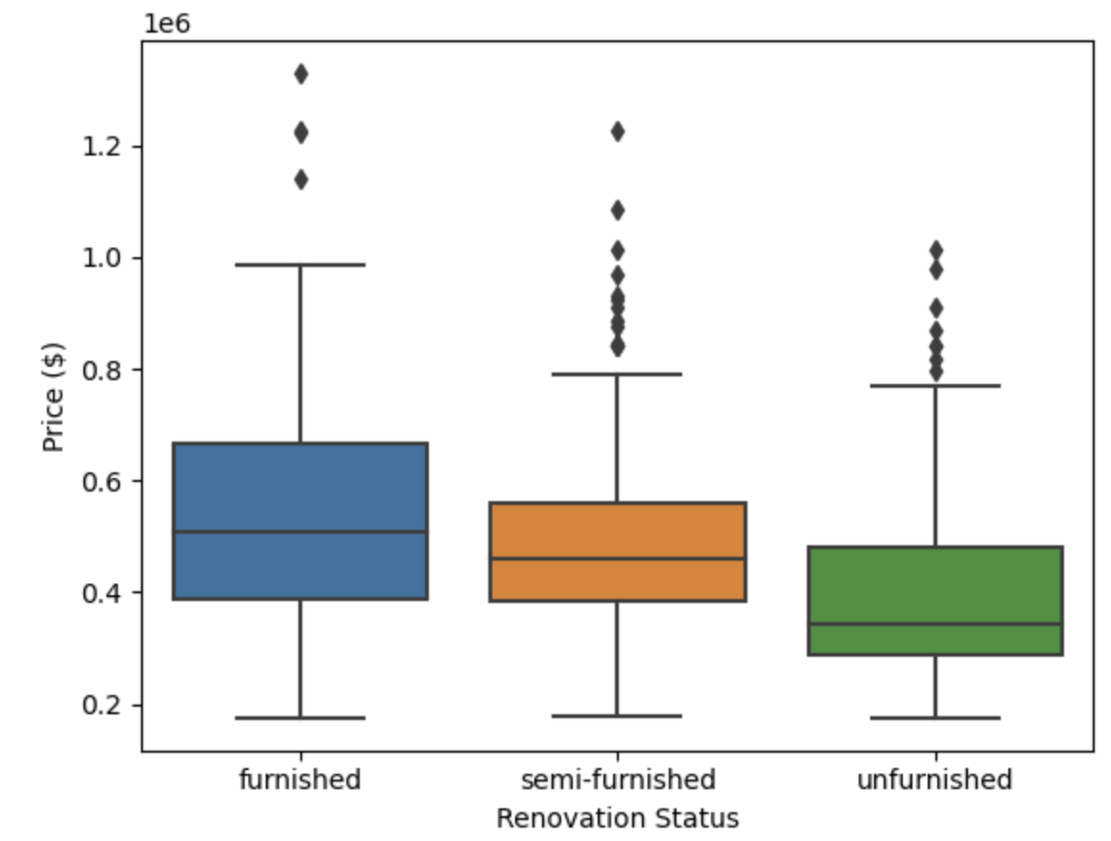
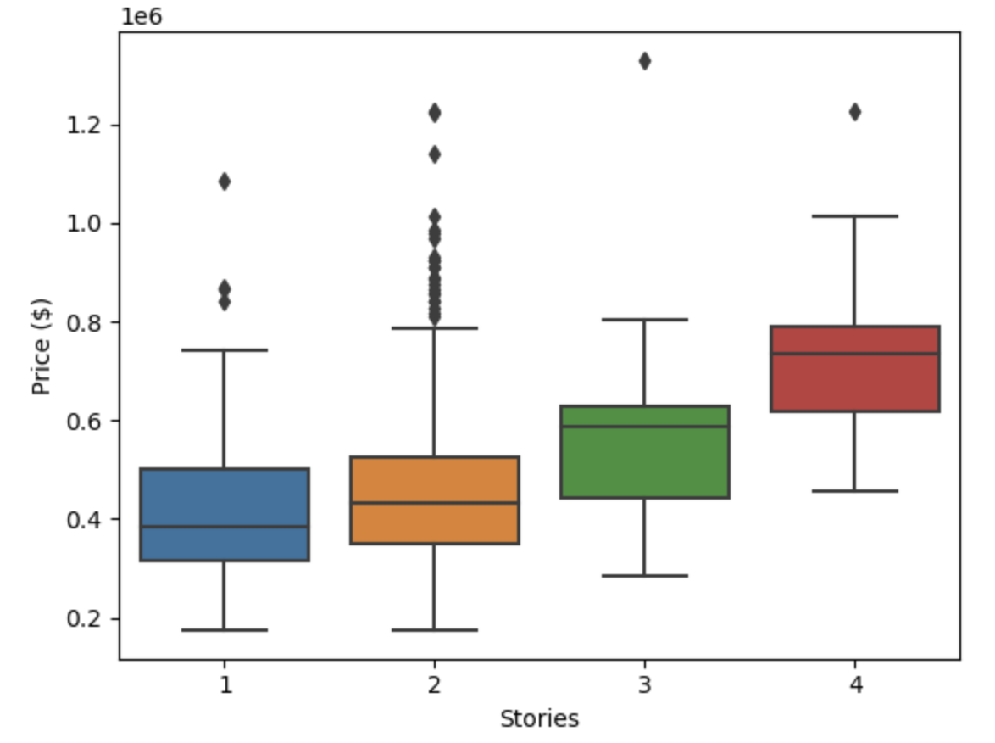
Data Exploration
Median housing prices are around the same price with Denver having the highest median housing price.
Median housing prices increases as the number of toilets in the house increase.
Median housing price for furnished is typically the highest, followed by semi-furnished then unfurnished
Median housing prices increases as the number of stories in the house increases

Slide 14
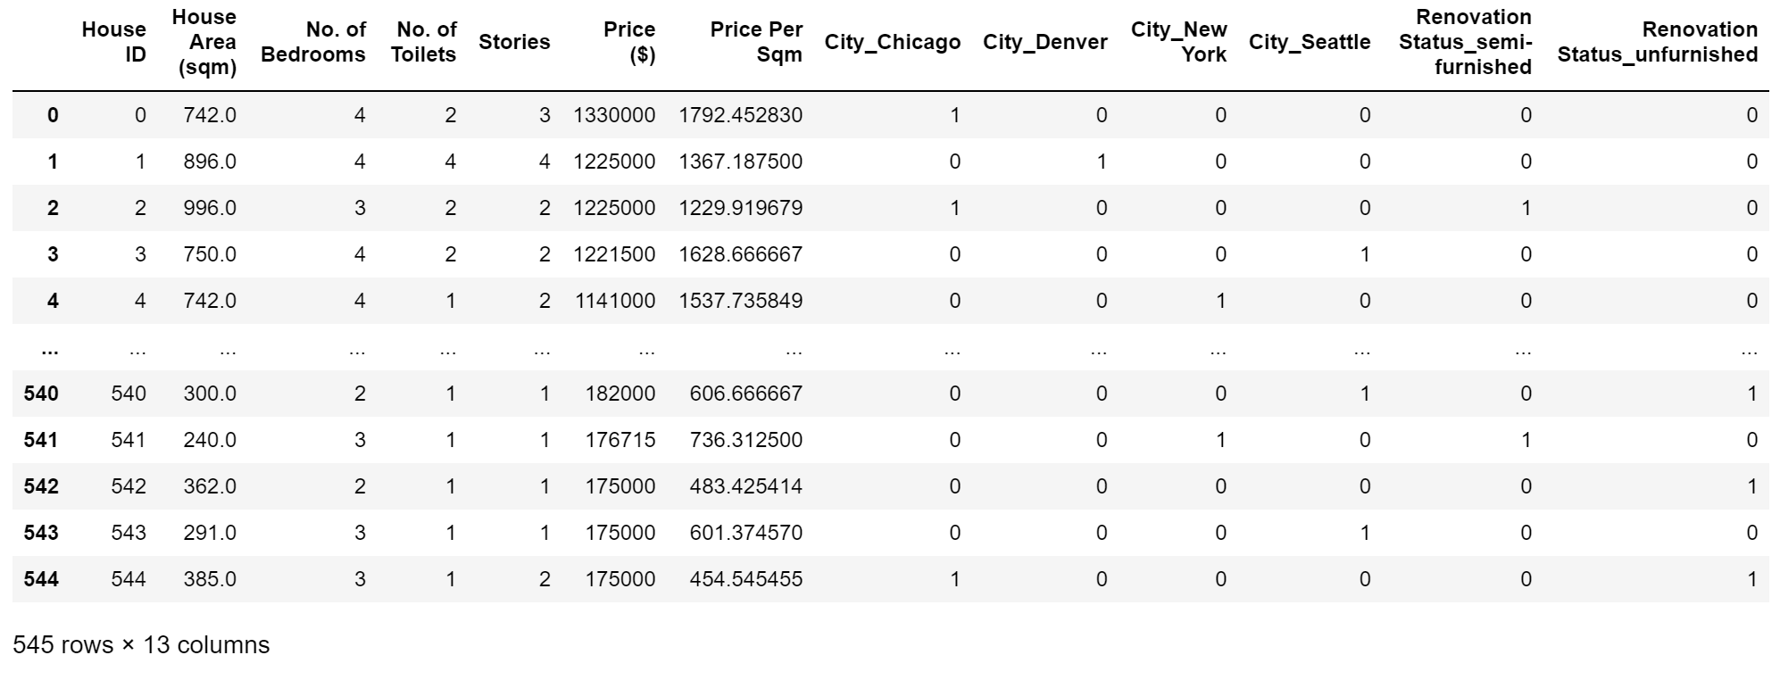
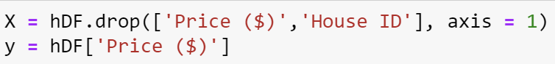
Data Preprocessing
1. Encoding Categorical Variable
Feature Engineering
Feature Selection
- Price Per Square Meter column was created to increase the predictive power of the algorithm.
X drops the target variable (‘Price ($)’) and identifying column (‘House ID’).
y is the target variable
(‘Price ($)’)

Slide 15
Algorithms Used
Gradient Boosting Regressor
Gradient Boosting for Regressor
Lots of flexibility, many options to choose from when hyperparameter tuning
Linear Regression
Random Forest Regressor
Gradient Boosting Regressor
HistGradientBoosting Regressor
Decision Tree Regressor
Extra Tree Regressor
HistGradientBoosting Regressor
- Is a Histogram-based Gradient Boosting Regression Tree
Linear Regression
Predict continuous variable
Easy to implement
Handles overfitting well
Extra Tree Regressor
Creates many decision trees and sampling of trees is random.
Reduction in bias
Decision Tree Regressor
Tree with decision nodes
Not easily affected by outlier
Random Forest Regressor
A Random Forest Regressor
Easy to interpret
Lots of flexibility, many options to choose from when hyperparameter tuning

Slide 16
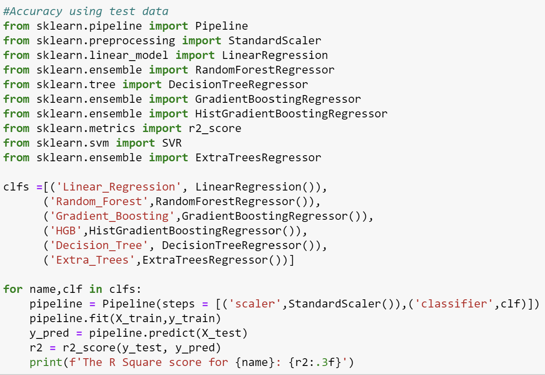
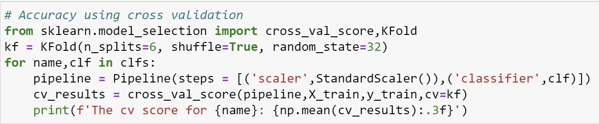
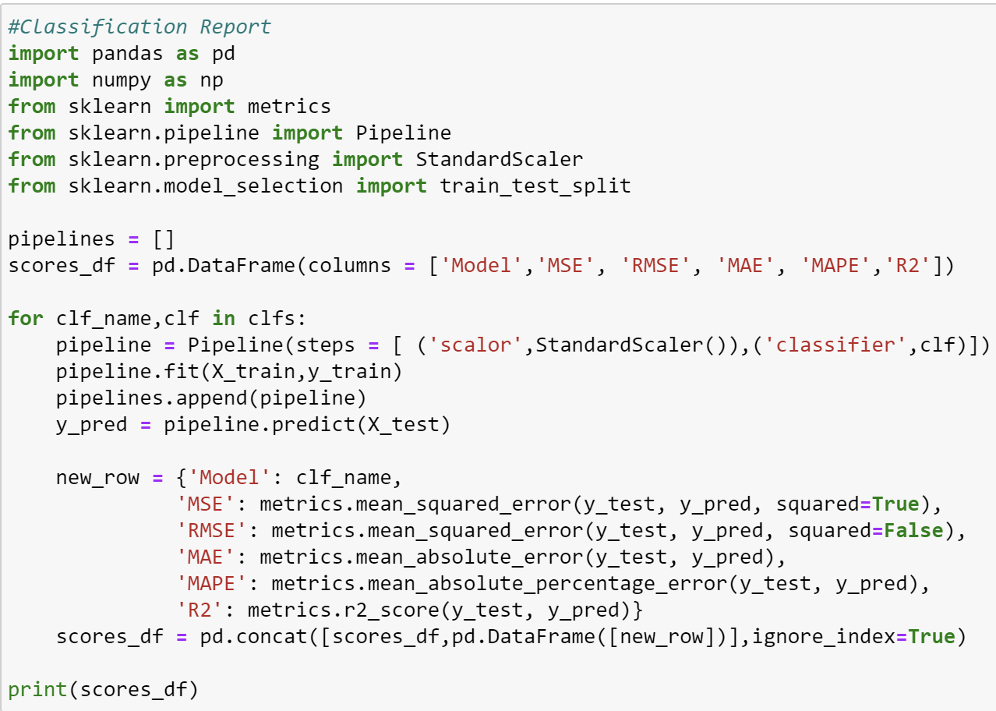
Test and Score Code (Before Hyperparameter Tuning)
Splitting Of Train And Test Data
An 80:20 ratio between training and test data is chosen where 80% of the data is for training and 20% is for testing
Test and Score

Slide 17
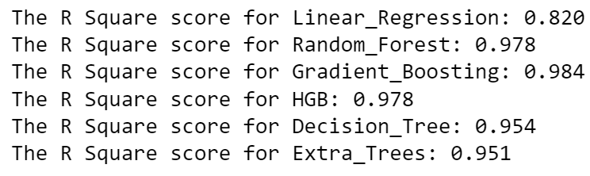
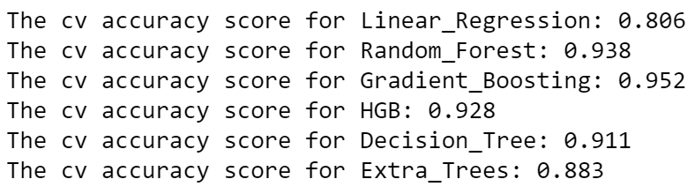
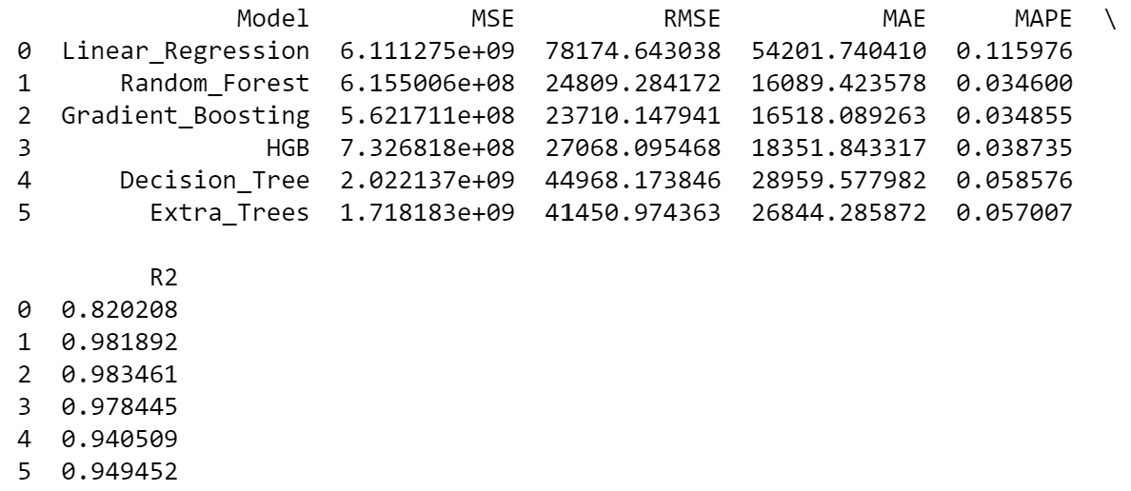
Test and Score (Before Hyperparameter Tuning)
R Square Score Using Test Data
R Square Score Using Cross Validation
From the test and score results, all models achieve a very high R square score of 0.90+ except for linear regression with a R Square score of 0.80+.
Gradient Boosting Algorithm has a highest R Square of 0.984 tested on test data compared to the other algorithms. This tells us that the model able to explain 98% of the variance whether one will default payment.
Not only that, it also has the highest cross-validation score of 0.952
Classification Report

Slide 18
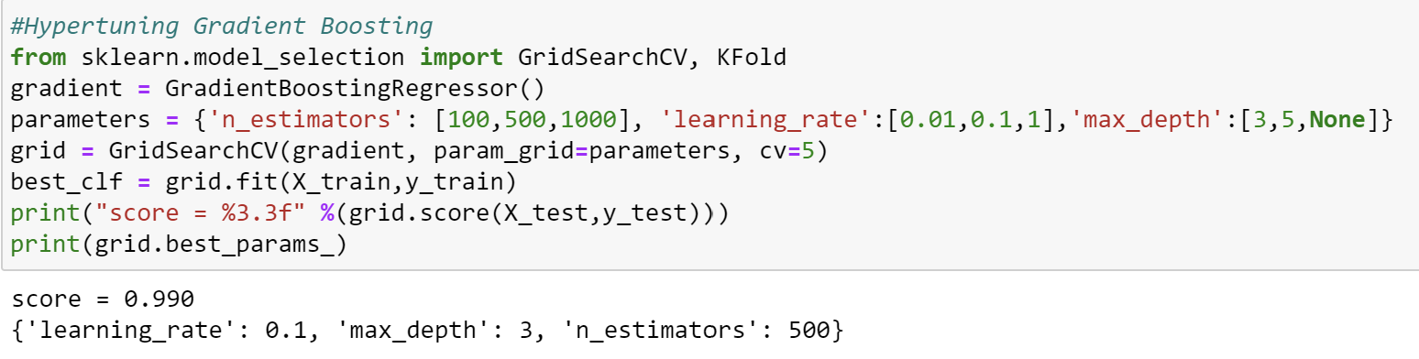
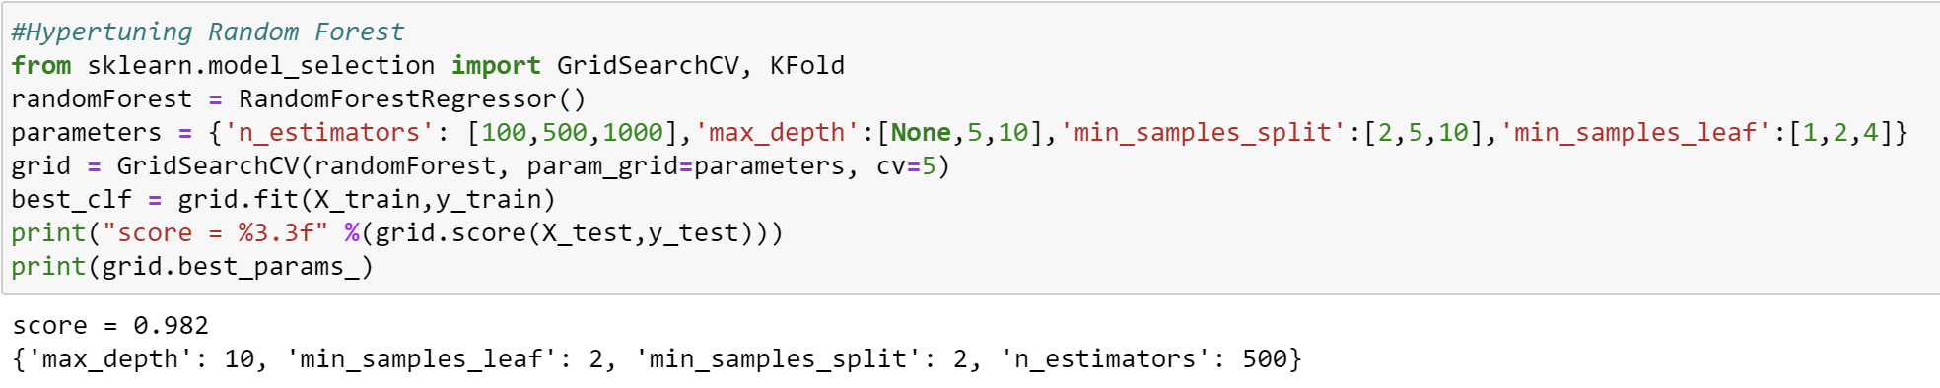
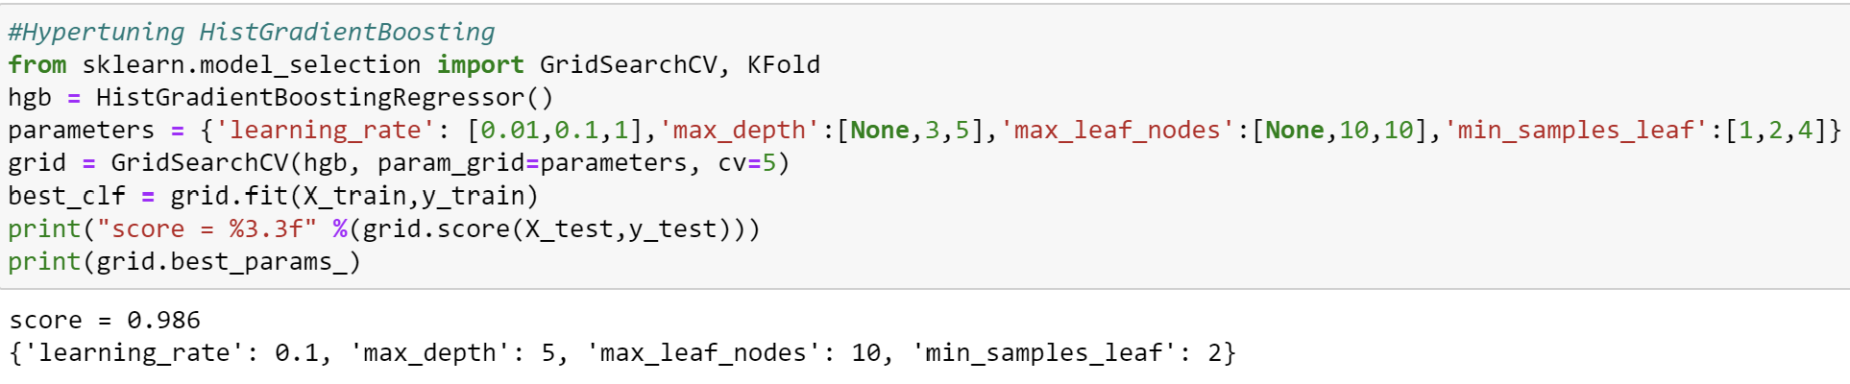
Hyperparameter Tuning
Picked out 3 of the most accurate model to hyperparameter tune.
Gradient Boosting
Random Forest
HistGradientBoosting
Now, I will hyperparameter tune the model to further improve the accuracy by customising the parameters for the algorithm.
Define a param grid for each model, and parameters I would like to test
GridSearchCV will loop through all the different types of combinations.
Upon looping through all the combinations, it will provide me with the best parameter combinations and highest R Square Score obtained.

Slide 19
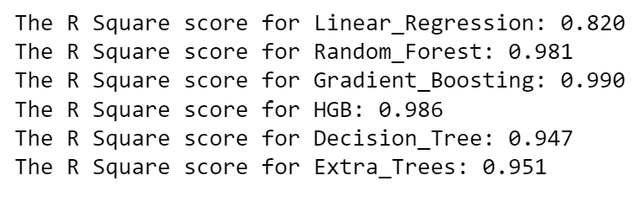
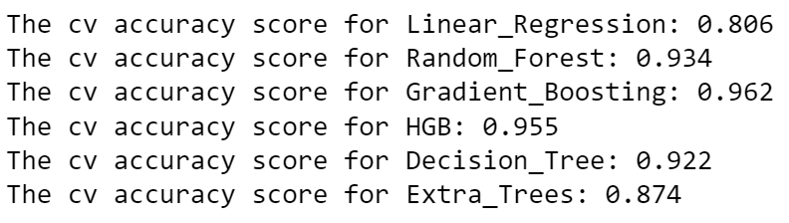
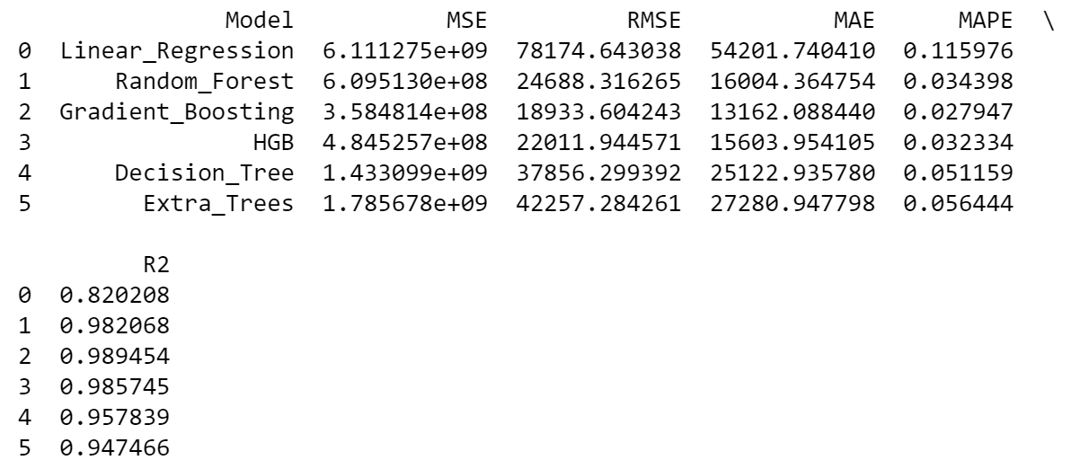
Test and Score (After Hyperparameter Tuning)
R Square Score On Test Data
After tuning the models,
Gradient Boosting
R Square Score on test data increased from 0.984 to 0.990.
Cross Validation Score increased from 0.952 to 0.962.
Random Forest
R Square Score on test data increased from 0.978 to 0.981.
Cross Validation Score decreased from 0.938 to 0.934.
Histogram Gradient Boosting
R Square Score on test data increased from 0.978 to 0.986.
Cross Validation Score increased from 0.928 to 0.955.
Overall, hyperparameter tuning has increased our model R Square Score in turn makes the model effective.
Cross Validation R Square Score
Classification Report
The MSE Score is of Gradient Boosting is the lowest.
The MAPE Score of Gradient Boosting is the lowest which tells us that on average, the model prediction differ by 2.7% from the actual value of housing prices.

Slide 20



Conclusion
In Conclusion, this dataset has given me a deep understanding on the housing price in US.
My model can capture complex patterns in the data and make more accurate predictions about housing prices.
Upon considering all 3 different accuracy reports Gradient Boosting is my most accurate model to predict housing prices.
From the Feature Importance Graph, the model heavily relies on the price per sqm and house area to predict housing prices.
Houses with higher price per square meter will be costlier.
Houses with bigger house area will be costlier
Comparing my model to a dummy baseline, the Mean Square Error has decreased, and my Model’s R Square Score increased.

